Slide 1

INSTITUTE UIE
DEPARTMENT ACADEMIC UNIT-1
Bachelor of Engineering (Computer Science & Engineering)
Subject Name Introduction Electrical & Electronics Engineering
Subject Code 23ECH-101
Prepared By
Dr. Shikha
Unit-2 Chapter-1
Combinational and Sequential Circuits
Lecture No. 2.1.2
FULL ADDERS
DISCOVER . LEARN . EMPOWER

Slide 2

Course Outcome
CO Number | Title | Level
CO1 | To identify the different types of electrical elements and the basic op-amp circuit elements and to illustrate the various types of motors, transducers. | Remember
CO2 | To understand basic principles of transformers, transducers, op-amps, DC and AC motors and to compare the different methods for analysing electrical and magnetic circuits. | Understand
CO3 | To derive the relationships between parameters in electric and magnetic circuits and motors and to determine specifications of op-amps. | Analyze
CO4 | To solve the basic problems related to electric circuits, magnetic circuits and motors and to assess the characteristics of different configurations of op-amps. | Evaluate
CO5 | To design the different applications of transducers, motors as well as the op-amps like adders, subtractor and comparators. | Create
Figure 1.1 Practical application of Full Adder [4]
Full Adder

Slide 3
TYPES OF ADDERS
BINARY ADDER
HALF ADDER
FULL ADDER
PARALLEL ADDER
RIPPLE CARRY
LOOK AHEAD CARRY
CARRY SAVE
Figure 5 Types of Adders

Slide 4
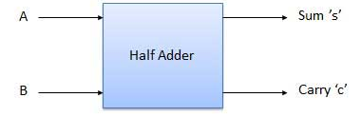
HALF ADDER
Half adder is a combinational logic circuit which add two input binary bits and will result sum and carry as output variables.
Figure 6 Block diagram of Half Adder

Slide 5
HALF ADDER
TRUTH TABLE
A | B | S | C
0 | 0 | 0 | 0
0 | 1 | 1 | 0
1 | 0 | 1 | 0
1 | 1 | 0 | 1
Figure 7 Block diagram of Half Adder
Boolean Expression
S = A’B + AB’
S= A⊕B C=A.B

Slide 6
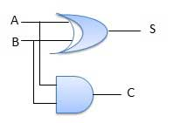
HALF ADDER
Realization of the Boolean Expression
Figure 8 Logic diagram of Half Adder

Slide 7
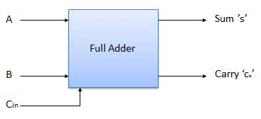
FULL ADDER
Full adder is a combinational logic circuit which add two input binary bits and previous carry and will result sum and carry as output variables.
Figure 1 Block diagram of Full Adder

Slide 8
FULL ADDER
TRUTH TABLE
A | B | C_{in} | _{S} | c
0 | 0 | 0 | 0 | 0
0 | 0 | 1 | 1 | 0
0 | 1 | 0 | 1 | 0
0 | 1 | 1 | 0 | 1
1 | 0 | 0 | 1 | 0
1 | 0 | 1 | 0 | 1
1 | 1 | 0 | 0 | 1
1 | 1 | 1 | 1 | 1
Figure 2 Truth Table of Full Adder

Slide 9
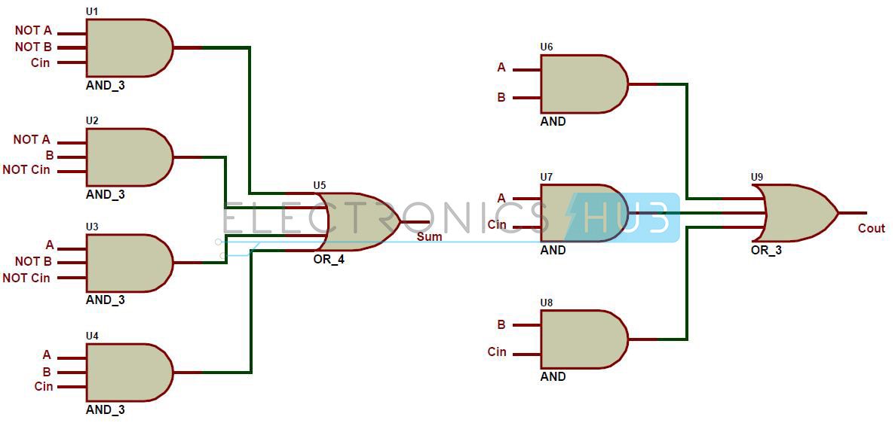
FULL ADDER
Figure 3 Logic Diagram using basic gates
BOOLEAN EXPRESSION:
S=Á’B’ C_{in}+A’BC_{in}’+AB’ C_{in}’+ABC_{in} C=AB+BC_{in}+C_{in}A

Slide 10
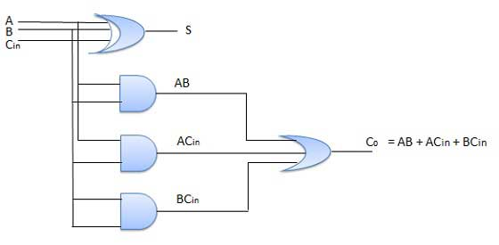
FULL ADDER
After Simplifying the Boolean Expression we obtain the following equation:
s= (A ⊕ B) ⊕ Cin
C=Cin(A ⊕ B)
Figure 4 Logic diagram of Full Adder

Slide 11
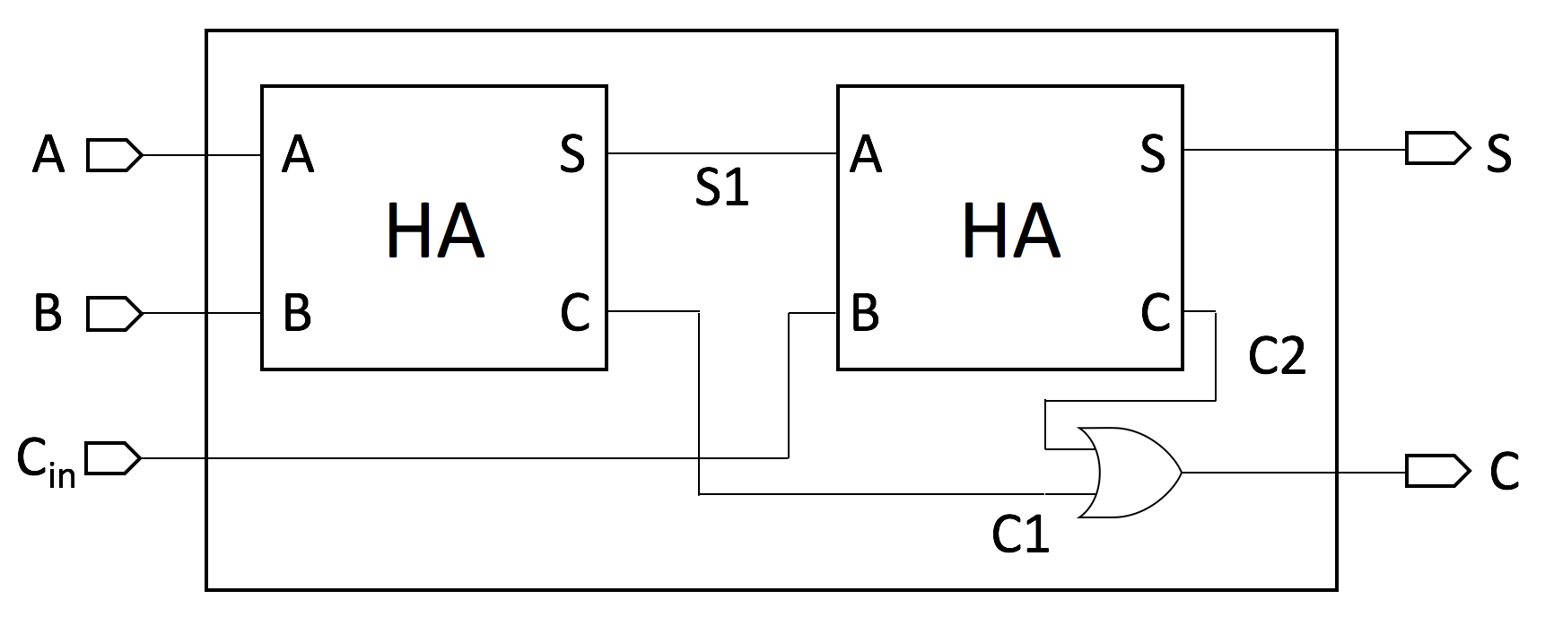
FULL ADDER
Figure 5 Logic diagram of FA using Half Adder

Slide 12
Assessment Pattern
Design full adder using 2 half adders
Design full adder using gates
Design a full adder using only Basic Gates.

Slide 13
APPLICATIONS
In ALU
Calculators
Delay Circuits

Slide 14
REFERENCES
https://www.tutorialspoint.com/computer_logical_organization/combinational_circuits.htm
https://www.google.com/url?sa=i&url=https%3A%2F%2Fwww.electronicshub.org%2Fhalf-adder-and-full-adder-circuits%2F&psig=AOvVaw3EEvl_U-utnhFfMkLwl-5x&ust=1595879743706000&source=images&cd=vfe&ved=0CAIQjRxqFwoTCKja3bzZ6-oCFQAAAAAdAAAAABAP
https://www.google.com/url?sa=i&url=https%3A%2F%2Ftechyelf.blogspot.com%2F2017%2F09%2Fvhdl-code-for-full-adder-using-half.html&psig=AOvVaw2hfmDDKfQ5KlYO-MCeAhTk&ust=1595880483842000&source=images&cd=vfe&ved=0CAIQjRxqFwoTCNi1lKTc6-oCFQAAAAAdAAAAABAa
https://www.google.com/url?sa=i&url=https%3A%2F%2Fwww.wired.com%2Fstory%2Fyou-can-power-a-calculator-with-some-leds%2F&psig=AOvVaw04qq4sVg6HobtSKaimt6_4&ust=1595881474357000&source=images&cd=vfe&ved=0CAIQjRxqFwoTCNDS9f7f6-oCFQAAAAAdAAAAABAc
Mano,Morris, Digital Design, Prentice Hall of India.
Fletcher, An Engg. Approach to digital design, Prentice Hall of India.

Slide 15
THANK YOU

